Slide 1




data_wrangling() &&
("manipulation" %in% R)
🐨🐟🌿 %>% %>% %>% 🤓📊🥰
postgraduate_workshop(
dept = "Biological Sciences",
presenter = c(
"Ruan van Mazijk",
"MSc candidate"
)
)
> face()
> logos()

Slide 2
> introduce( )

Slide 3
> introduce( )
BSc + Hons here at UCT

Slide 4
> introduce( )
BSc + Hons here at UCT
Ecology & evolution
(Mostly plant) comparative biology
Biogeography

Slide 5
> introduce( )
BSc + Hons here at UCT
Ecology & evolution
(Mostly plant) comparative biology
Biogeography
Been working with R for 4½ years
Every major project I’ve done…

Slide 6
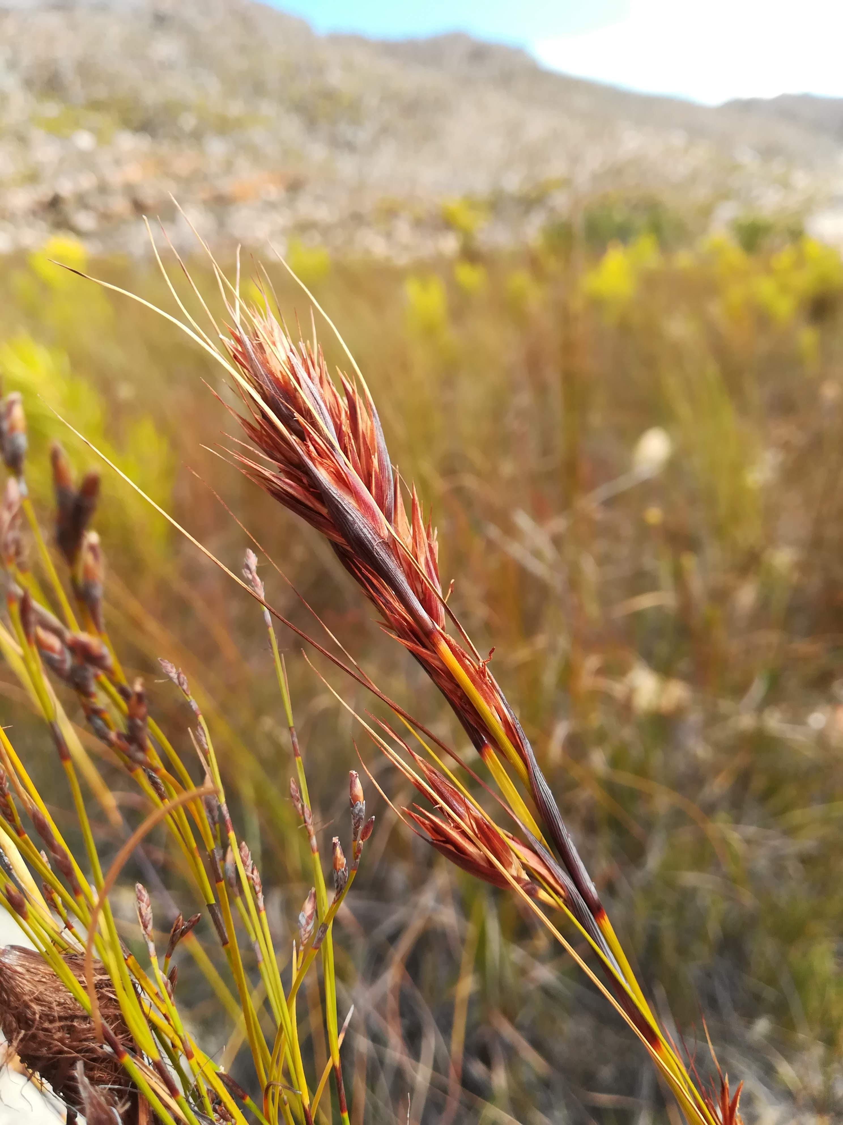
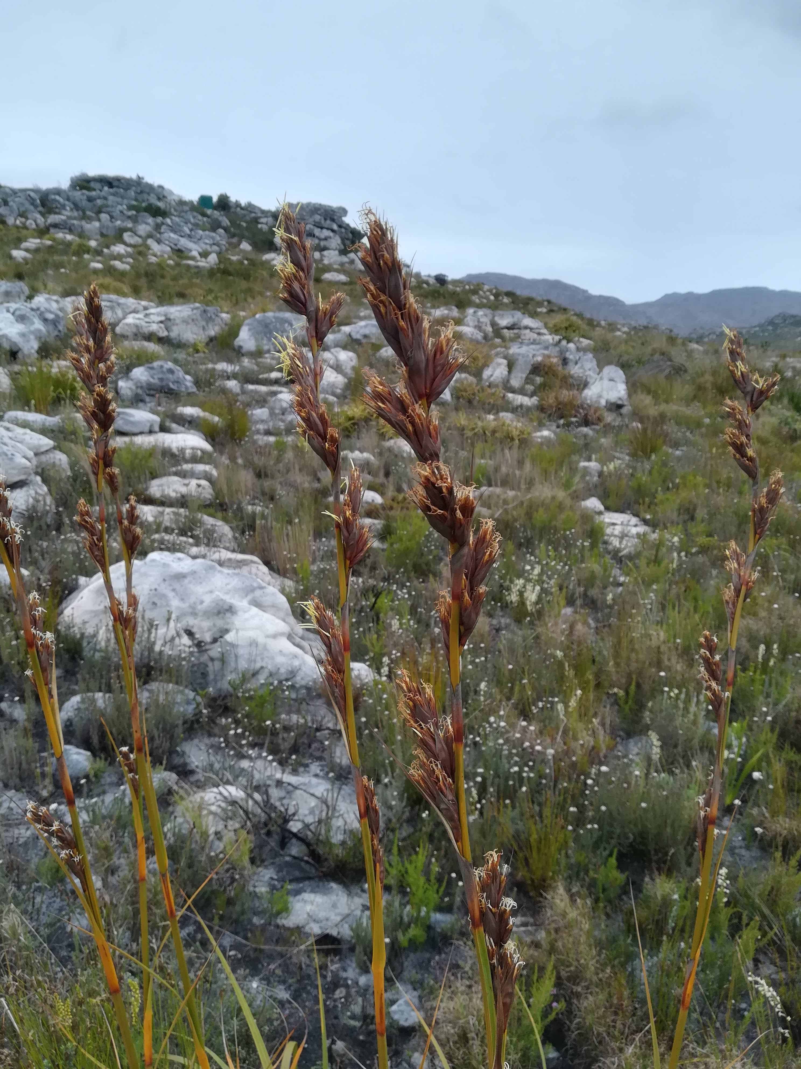
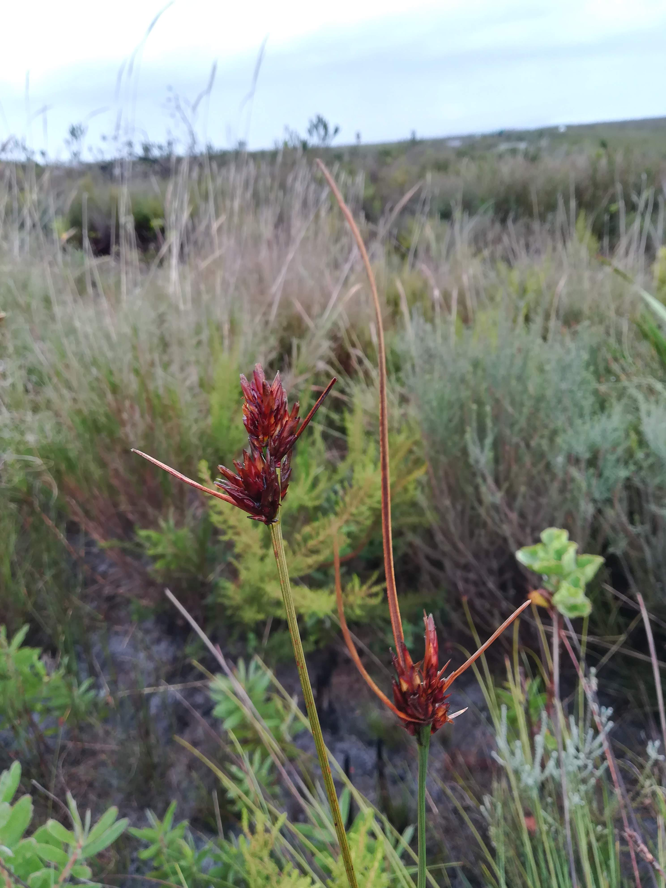
> introduce( )
Tetraria ustulata
Marloth NR
R. van Mazijk 2018
Tetraria thermalis
Silvermine, Table Mountain NP
R. van Mazijk 2018
Schoenus compar
Silvermine, Table Mountatin NP
R. van Mazijk 2018

Slide 7
> workshop$goals

Slide 8
> workshop$goals
More reproducible science

Slide 9
> workshop$goals
More reproducible science
Save time by:
Automating repetitive tasks
Eliminating human error

Slide 10
> workshop$goals
More reproducible science
Save time by:
Automating repetitive tasks
Eliminating human error
Boost your skills
Think about your data programmatically

Slide 11
Notes & slides will go up here:
tinyurl.com/r-with-ruan
(But I encourage you to make your own notes!)

Slide 12
> workshop$outline

Slide 13
> workshop$outline[1:3]

Slide 14
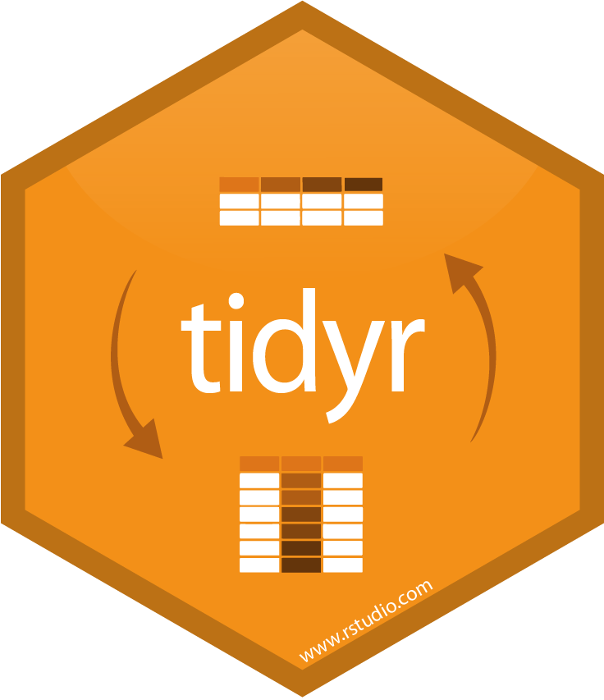
> workshop$outline[1:3]
DAY 1
Tidy data principles
& tidyr

Slide 15

> workshop$outline[1:3]
DAY 1
Tidy data principles
& tidyr
DAY 2
Manipulating data
& an intro to dplyr
DAY 3
Extending your data
with mutate(),
summarise()
& friends

Slide 16
> workshop$outline[-(1:3)]

Slide 17
> workshop$outline[-(1:3)]
2 dialects of R:

Slide 18
> workshop$outline[-(1:3)]
2 dialects of R:
base
$ [] [[]]
apply() which() subset()

Slide 19



> workshop$outline[-(1:3)]
2 dialects of R:
base
$ [] [[]]
apply() which() subset()
tidyverse

Slide 20
data <- read.csv("my-data.csv")

Slide 21
😅
data <- read.csv("my-data.csv")
data1 <- f(data, arg1 = "something")

Slide 22
😅 😥
data <- read.csv("my-data.csv")
data1 <- f(data, arg1 = "something")
data2 <- g(data1, another.thing = "blah")

Slide 23
😅 😥 😰
data <- read.csv("my-data.csv")
data1 <- f(data, arg1 = "something")
data2 <- g(data1, another.thing = "blah")
data3 <- h(data2, a.setting = TRUE)

Slide 24
😅 😥 😰 🤕
data <- read.csv("my-data.csv")
data1 <- f(data, arg1 = "something")
data2 <- g(data1, another.thing = "blah")
data3 <- h(data2, a.setting = TRUE)
data4 <- data3[data3$a.column == "cough", ]

Slide 25
😅 😥 😰 🤕
data <- read.csv("my-data.csv")
data1 <- f(data, arg1 = "something")
data2 <- g(data1, another.thing = "blah")
data3 <- h(data2, a.setting = TRUE)
data4 <- data3[data3$a.column == "cough", ]

Slide 26
data <- read.csv("my-data.csv")

Slide 27
data <- read.csv("my-data.csv")
data <-
data

Slide 28
data <- read.csv("my-data.csv")
data <-
f(data, arg1 = "something")

Slide 29
data <- read.csv("my-data.csv")
data <-
g(
f(data, arg1 = "something"),
another.thing = "blah"
)

Slide 30
data <- read.csv("my-data.csv")
data <-
h(
g(
f(data, arg1 = "something"),
another.thing = "blah"
),
a.setting = TRUE
)

Slide 31
😐
data <- read.csv("my-data.csv")
data <-
h(
g(
f(data, arg1 = "something"),
another.thing = "blah"
),
a.setting = TRUE
)

Slide 32
😐
data <- read.csv("my-data.csv")
data <-
h(
g(
f(data, arg1 = "something"),
another.thing = "blah"
),
a.setting = TRUE
)

Slide 33
😐
data <- read.csv("my-data.csv")
data <-
h(
g(
f(data, arg1 = "something"),
another.thing = "blah"
),
a.setting = TRUE
)

Slide 34
😐
data <- read.csv("my-data.csv")
data <-
h(
g(
f(data, arg1 = "something"),
another.thing = "blah"
),
a.setting = TRUE
)

Slide 35
😐
data <- read.csv("my-data.csv")
data <-
h(
g(
f(data, arg1 = "something"),
another.thing = "blah"
),
a.setting = TRUE
)
data <- data[data$a.column == "cough", ]
🤬

Slide 36
Solution: the pipe!
%>%

Slide 37
Solution: the pipe!
%>%
{ } [ ] [[ ]] <- = ( ) , " " ' '

Slide 38
Read: “then”
Solution: the pipe!
%>%
{ } [ ] [[ ]] <- = ( ) , " " ' '

Slide 39
f(x)

Slide 40
f(x) sort(1:10)

Slide 41
f(x) sort(1:10)
x %>% f()

Slide 42
f(x) sort(1:10)
x %>% f() 1:10 %>% sort()

Slide 43
f(x, y) t.test(data$x, data$y)

Slide 44
f(x, y) t.test(data$x, data$y)
x %>% f(y) data$x %>% t.test(data$y)

Slide 45
😐
data <- read.csv("my-data.csv")
data <-
h(
g(
f(data, arg1 = "something"),
another.thing = "blah"
),
a.setting = TRUE
)
data <- data[data$a.column == "cough", ]

Slide 46
h(g(f(x)))

Slide 47
h(g(f(x)))
x %>%

Slide 48
h(g(f(x)))
x %>%
f() %>%

Slide 49
h(g(f(x)))
x %>%
f() %>%
g() %>%

Slide 50
h(g(f(x)))
x %>%
f() %>%
g() %>%
h()

Slide 51
data <- read.csv("my-data.csv")
data <-
h(
g(
f(data, arg1 = "something"),
another.thing = "blah"
),
a.setting = TRUE
)

Slide 52
data <- read.csv("my-data.csv")
data <- data %>%
f(arg1 = "something") %>%
g(another.thing = "blah") %>%
h(a.setting = TRUE)

Slide 53
data <- read.csv("my-data.csv")
data <- data %>%
f(arg1 = "something") %>%
g(another.thing = "blah") %>%
h(a.setting = TRUE)
???????
🤭
data <- data[data$a.column == "cough", ]

Slide 54
> workshop$outline[1:3]
DAY 1
Tidy data principles
& tidyr
DAY 2
Manipulating data
& an intro to dplyr
DAY 3
Extending your data
with mutate(),
summarise()
& friends

Slide 55
> workshop$outline[[1]]
DAY 1
Tidy data principles
& tidyr

Slide 56
> workshop$outline[[1]]
DAY 1
Tidy data principles
& tidyr

Slide 57
A motivating example…

Slide 58
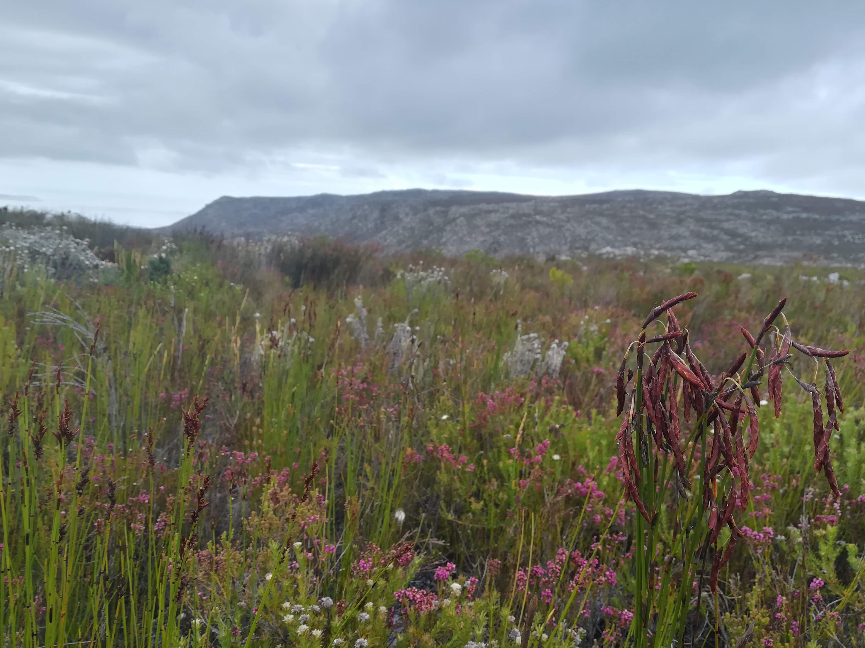
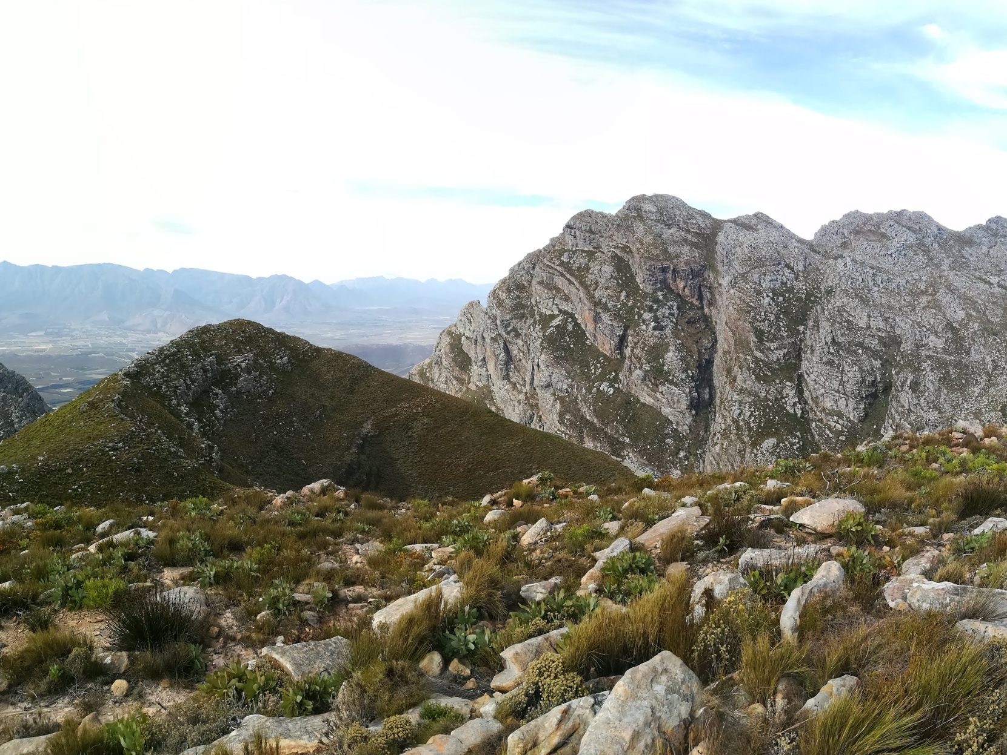
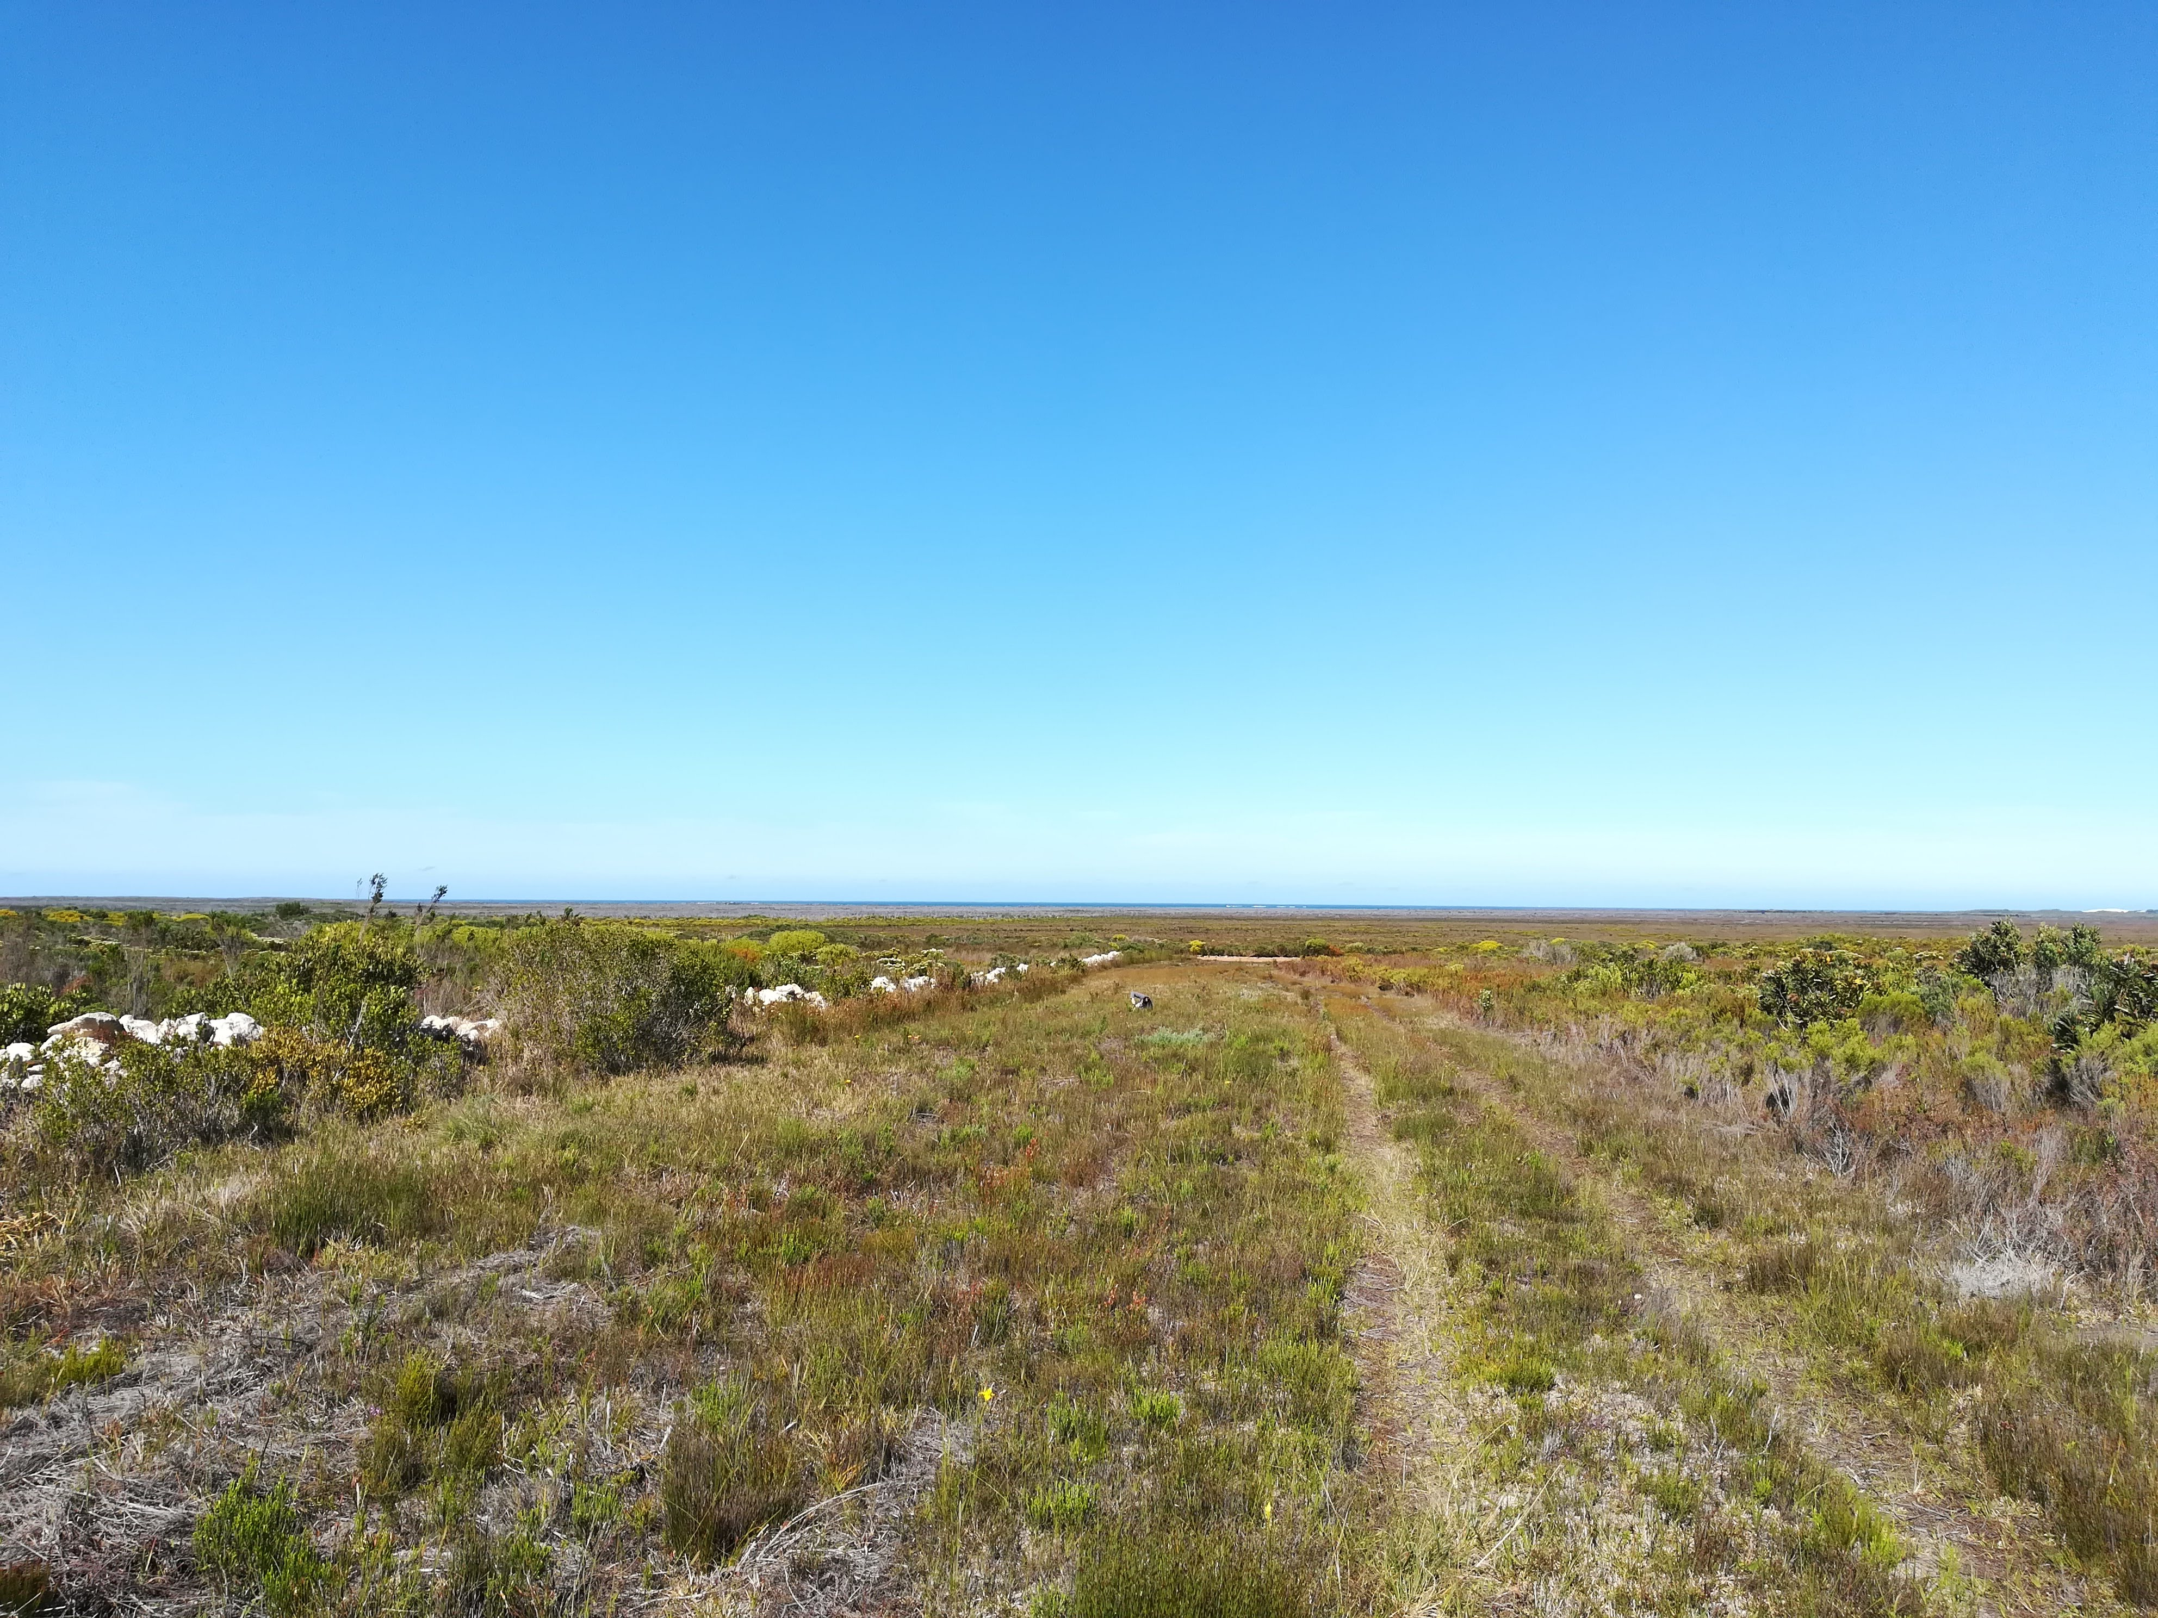
Kogelberg NR,
R. van Mazijk 2019
Observation Pk,
R. van Mazijk 2018
Near Pearly Beach, Agulhas Plains,
R. van Mazijk 2018
An example data-collection scenario in biology

Slide 59
Kogelberg NR,
R. van Mazijk 2019
Observation Pk,
R. van Mazijk 2018
Near Pearly Beach, Agulhas Plains,
R. van Mazijk 2018
An example data-collection scenario in biology

Slide 60

Kogelberg NR,
R. van Mazijk 2019
Observation Pk,
R. van Mazijk 2018
Near Pearly Beach, Agulhas Plains,
R. van Mazijk 2018
An example data-collection scenario in biology

Slide 61

Kogelberg NR,
R. van Mazijk 2019
Observation Pk,
R. van Mazijk 2018
Near Pearly Beach, Agulhas Plains,
R. van Mazijk 2018
An example data-collection scenario in biology

Slide 62

Kogelberg NR,
R. van Mazijk 2019
Observation Pk,
R. van Mazijk 2018
Near Pearly Beach, Agulhas Plains,
R. van Mazijk 2018
An example data-collection scenario in biology

Slide 63
One way to lay out your collected data… 🤢

Slide 64
Site 1 |  |  | Site 2 |  |  | Site 3
Sp 1 | Sp 2 | Sp 3 | Sp 1 | Sp 2 | Sp 3 | Sp 1 | Sp 2 | Sp 3
One way to lay out your collected data… 🤢

Slide 65
Site 1 |  |  | Site 2 |  |  | Site 3
Sp 1 | Sp 2 | Sp 3 | Sp 1 | Sp 2 | Sp 3 | Sp 1 | Sp 2 | Sp 3
One way to lay out your collected data… 🤢

Slide 66
Site 1 |  |  | Site 2 |  |  | Site 3
Sp 1 | Sp 2 | Sp 3 | Sp 1 | Sp 2 | Sp 3 | Sp 1 | Sp 2 | Sp 3

Slide 67
Site 1 |  |  | Site 2 |  |  | Site 3
Sp 1 | Sp 2 | Sp 3 | Sp 1 | Sp 2 | Sp 3 | Sp 1 | Sp 2 | Sp 3
???

Slide 68
Site 1 |  |  | Site 2 |  |  | Site 3
Sp 1 | Sp 2 | Sp 3 | Sp 1 | Sp 2 | Sp 3 | Sp 1 | Sp 2 | Sp 3
🤢
???

Slide 69
Site 1 |  |  | Site 2 |  |  | Site 3
Sp 1 | Sp 2 | Sp 3 | Sp 1 | Sp 2 | Sp 3 | Sp 1 | Sp 2 | Sp 3
🤢
???
😤

Slide 70
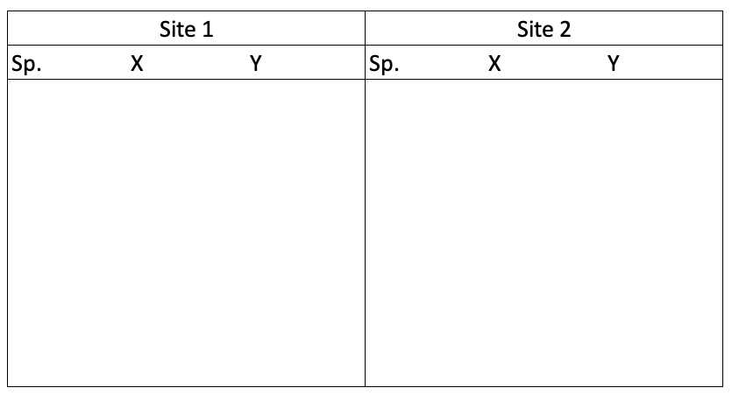
Another way… 😬

Slide 71
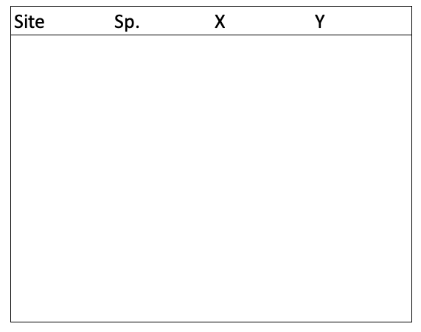
😍😘
👄😳
The “best” way.
(Will make your life easiest in the long-term.)

